Slide 1
Design
Ying shen
School of software engineering
Tongji university

Slide 2
Outline
Introduction
The Design Process
Design Frameworks
Design Methods
Design Tools, Practices, and Patterns
Social Impact Analysis
Legal Issues

Slide 3
Outline
Introduction
The Design Process
Design Frameworks
Design Methods
Design Tools, Practices, and Patterns
Social Impact Analysis
Legal Issues

Slide 4
Introduction
Design can be loosely defined as the outcome or the process of creating specifications for synthetic artifacts.
All manufactures objects are the result of some form of design process
User interfaces
Now interaction design is defined as making plans and specifications for digital objects, such as devices, interfaces, services, and information.

Slide 5
Introduction
Early designs are highly functional but cruel to users.
Early computer applications are designed highly functional for programmers
Current users are more oriented toward their professional or recreational needs
Every time designers create a new digital artifact, they make decision
Functions are not only the important aspect of a digital object
Form is another aspect, which sometimes comes in conflict with function

Slide 6
Introduction
One of the key characteristics of digital media is that they are freely reproducible without consuming the original copy or costing additional resources.
Information technology is a “material without qualities”
With no constraints, interaction designers are often left with a much more daunting problem than designers working in the real world.
The design is unpredictable and dynamic, which requires a robust and flexible design process

Slide 7
Outline
Introduction
The Design Process
Design Frameworks
Design Methods
Design Tools, Practices, and Patterns
Social Impact Analysis
Legal Issues

Slide 8
The design process
Scenario-based design characterization:
Design is a process, not a state
The design process is nonhierarchical
The process is radically transformational
Design intrinsically involves the discovery of new goals

Slide 9
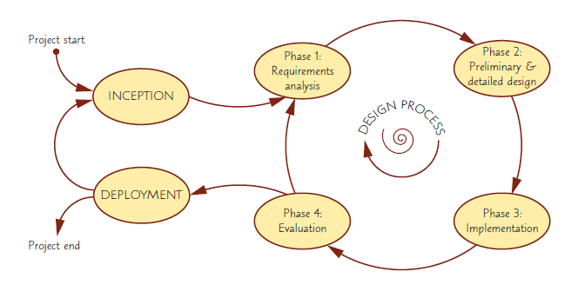
The design process
An iterative design process would consist of four distinct phases

Slide 10
Phase 1 - Requirements analysis
This phase collects all the necessary requirements for an interactive system or device and yields a requirements specification or document
Soliciting, capturing, and specifying user requirements are major keys
The specification contains three components:
Functional requirements: define specific system behavior using use cases
Non-functional requirements: specify overall criteria, like hardware, software, system performance, reliability, etc.
User experience requirements: specify non-functional requirements for the user interaction, like navigation, input, color, etc.

Slide 11
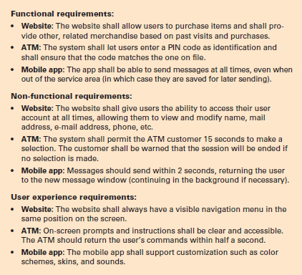
Phase 1 - Requirements analysis
Examples of requirements regarding system behavior for three distinct types of interactive systems:
E-commerce website
ATM
Mobile messaging app

Slide 12
Phase 2 – Preliminary and detailed design
The design phase in turn consists of two stages:
A preliminary stage, where the high-level design or architecture of the interactive system is derived
A detailed stage, where the specifics of each interaction is planned out
The preliminary stage is also called architectural or conceptual design
This activity is about developing the mental model that users should have about the interactive system when using it
Is system focused on a central view or is it a sequence of forms or a set of linked displays?
Is it an app that integrates with other apps to pop up on demand, or is it intended for focused and sustained use?

Slide 13
Phase 2 – Preliminary and detailed design
The high-level concepts and their relations provides a starting point for the detailed design
One difficulty is that customers and users may not have a clear idea of what the system will look like
Examples of suitable design methods include sketching, paper mockups, and high-fidelity prototypes
Can be clarified via tools, patterns, best practices

Slide 14
Phase 3 – Build and implementation
Where all the planning gets turned into actual, running code
The actual software and hardware engineering needed to achieve this are outside the scope of this book
Included in this text is software development platforms for interactive applications for mobile apps, the web and PC’s
Make sure to evaluate tool capabilities, ease of use, ease to learn, cost, and performance
Tailor tool choices for the size of the job
Notes:
微信小程序开发

Slide 15
Phase 4 – Evaluation
Developers test and validate the system implementation to ensure that it conforms to the requirements and design set out earlier in the process
A straightforward approach is to check that each use case can be completed successfully
The design team can decide to proceed with production or to continue another design cycle
First, carry out many small and some large pilot tests of components
Then, test with more intended users
Procedures vary greatly depending on the goals of the usability study, the number of expected users, etc.

Slide 16
Outline
Introduction
The Design Process
Design Frameworks
Design Methods
Design Tools, Practices, and Patterns
Social Impact Analysis
Legal Issues

Slide 17
Design frameworks
User-centered design (UCD)
Takes the needs, wants, and limitations of the actual end users into account during each phase of the design process
Participatory design (PD)
Direct involvement of people in the collaborative design of the things and technologies they use
Agile interaction design
Development methods for self-organizing, dynamic teams and that facilitate flexible, adaptive, and rapid development that is robust to changing requirements and needs

Slide 18
User-centered design
UCD prescribes a design process that primarily takes the needs, wants, and limitations of the actual end users into account
Systems generate fewer problems during development and have lower maintenance costs
General phases of User-Centered Design process
Specify context of use
Specify Requirements
Create design solutions and development
Evaluate Product

Slide 19
User-centered design
User involvement is also a significant challenge
Finding users may be difficult
have to select a manageable number of representative users
users may be unable or unwilling to participate
users often lack the technical expertise to communicate with designers
Many users may not have clear understanding of what they need in the new system

Slide 20
Participatory design
PD is involvement of people in the collaborative design of the things
Many variations engage participants to create dramatic performances, photography exhibits, game, or merely sketches and written scenarios
High-fidelity prototypes and simulations can also be key in eliciting user requirements
Notes:
More user involvement brings more accurate information about asks and an opportunity for users to influence design decisions
Extensive user involvement may be costly and may lengthen the implementation period

Slide 21
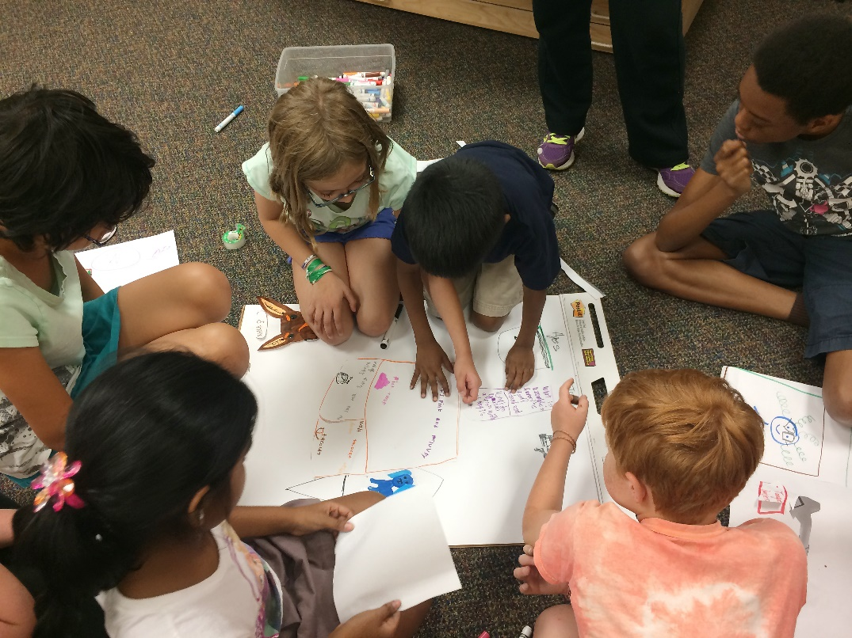
Participatory design
Intergenerational and interdisciplinary design team from the University of Maryland’s KidsTeam working on new human-computer interaction technologies using paper prototypes

Slide 22
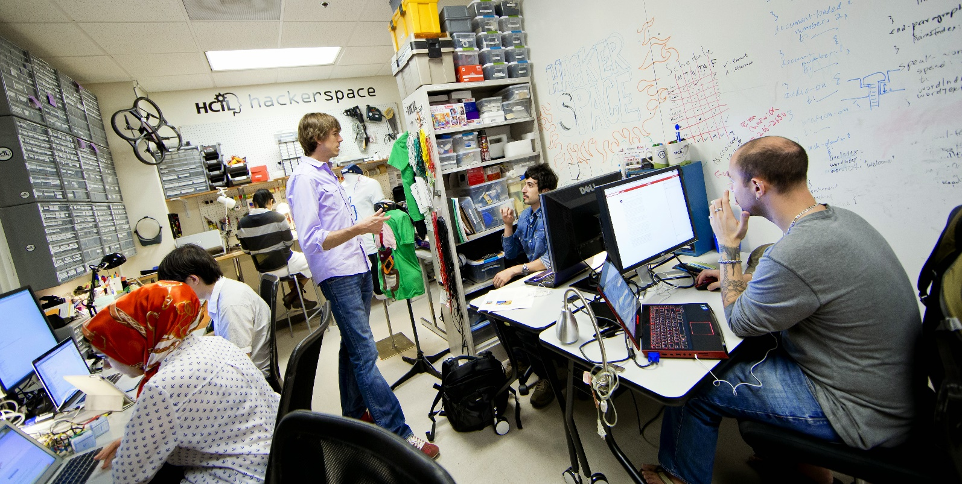
Agile interaction design
Professor Jon Froehlich and his students working in the HCIL Hackerspace at University of Maryland, College Park
Notes:
https://www.youtube.com/watch?v=eIOUkNxd4Jo

Slide 23
Outline
Introduction
The Design Process
Design Frameworks
Design Methods
Design Tools, Practices, and Patterns
Social Impact Analysis
Legal Issues

Slide 24
Design methods
Practical building blocks that form the actual day-to-day activities in the design process
Ideation and creativity
Surveys, interviews and focus groups
Ethnographic observation
Scenario development and storyboarding
Prototyping

Slide 25
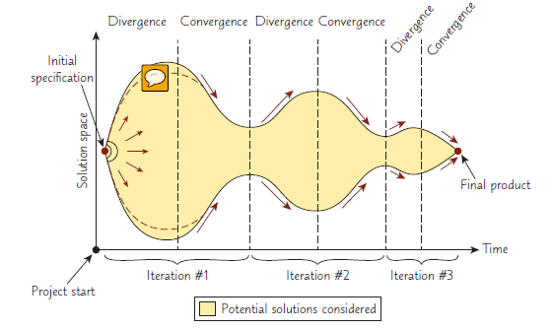
Design methods
Illustration of how the solutions considered during a design process will grow (diverge) and shrink (converge) iteratively until it eventually fixates on a single point, the finished product
This particular design process involves three iterations, but real processes may have more or fewer iterations.

Slide 26
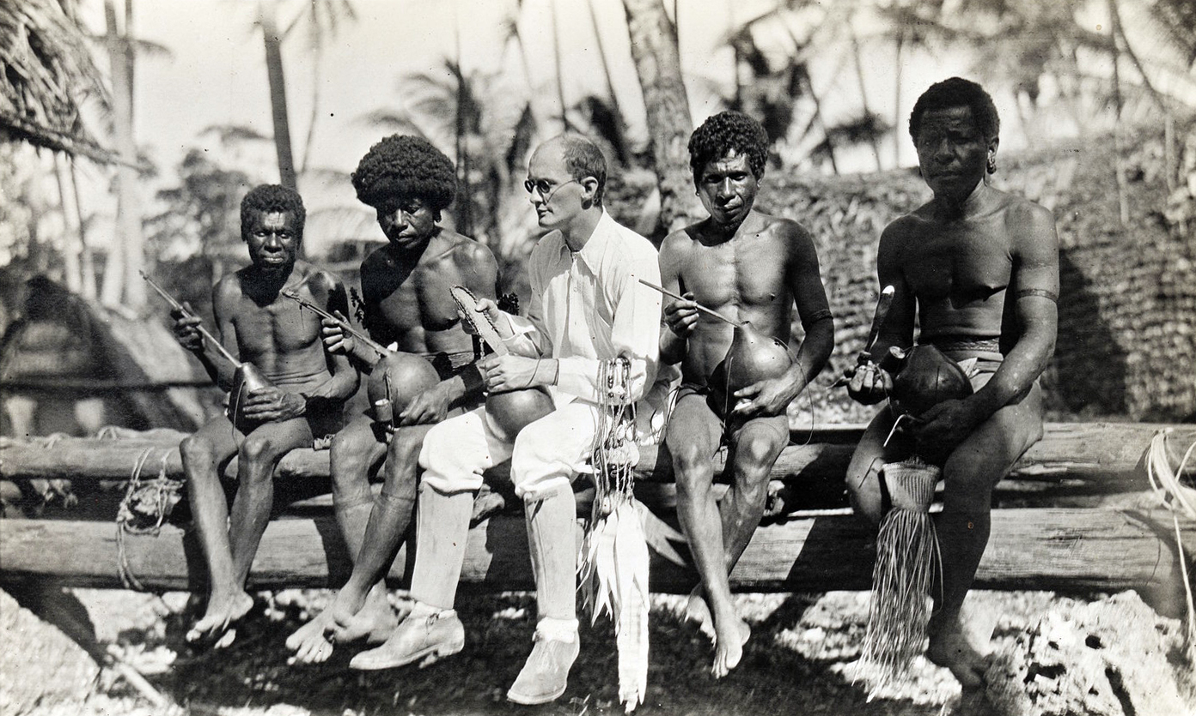
Ethnographic observation
Malinowski with natives, Trobriand Islands, 1918

Slide 27
Ethnographic observation
Preparation
Understand organization policies and work culture
Familiarize yourself with the system and its history
Set initial goals and prepare questions
Gain access and permission to observe/interview
Field Study
Establish rapport with managers and users
Observe/interview users in their workplace and collect subjective/objective quantitative/qualitative data
Follow any leads that emerge from the visits

Slide 28
Ethnographic observation
Analysis
Compile the collected data in numerical, textual, and multimedia databases
Quantify data and compile statistics
Reduce and interpret the data
Refine the goals and the process used
Reporting
Consider multiple audiences and goals
Prepare a report and present the findings

Slide 29
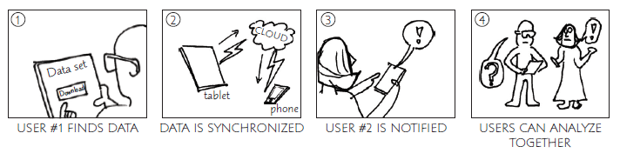
Storyboarding
Hand-drawn storyboard for a collaborative software that allows multiple people to view a common dataset using their personal smartphones and tablets

Slide 30
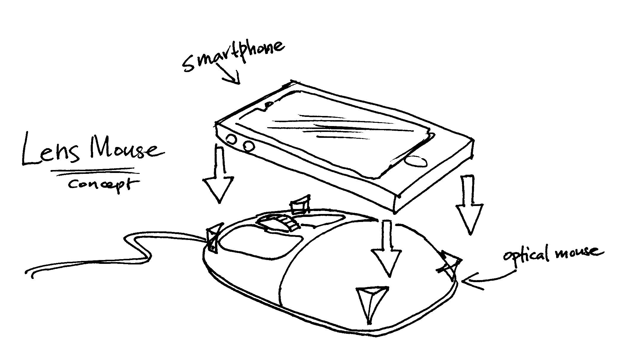
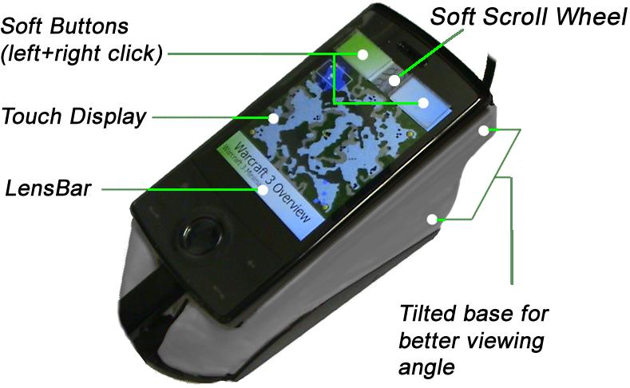
Prototyping
Low-fidelity prototypes are generally created by sketching, using post-it notes, or cutting and gluing pieces of paper together (paper mockups)
Medium-fidelity prototypes are often called wireframes, and provide some standardized elements (such as buttons, menus, and text fields), even if potentially drawn in a sketchy fashion, and has some basic navigation functionality
High-fidelity prototypes look almost like the final product and may have some rudimentary computational capabilities; however, the prototype is typically not complete and may not be fully functional

Slide 31
Outline
Introduction
The Design Process
Design Frameworks
Design Methods
Design Tools, Practices, and Patterns
Social Impact Analysis
Legal Issues

Slide 32
Design tools
Dedicated prototyping design tools are specifically designed for the purpose of creating interface mockups rapidly and effortlessly
Design Tools
MS PowerPoint presentation
Adobe InDesign
Photoshop
Illustrator

Slide 33
Design patterns
Interaction Design Patterns
Best-practice solutions to commonly occurring problems specified in such a way that they can be reused and applied to slightly different variations of a problem over and over again
Model-View-Controller (MVC), document interface, Web app page architecture

Slide 34
Outline
Introduction
The Design Process
Design Frameworks
Design Methods
Design Tools, Practices, and Patterns
Social Impact Analysis
Legal Issues

Slide 35
Social impact analysis
Describe the new system and its benefits
Convey the high level goals of the new system
Identify the stakeholders
Identify specific benefits

Slide 36
Social impact analysis
Address concerns and potential barriers
Anticipate changes in job functions and potential layoffs
Address security and privacy issues
Discuss accountability and responsibility for system misuse and failure
Avoid potential biases
Weigh individual rights vs. societal benefits
Assess trade-offs between centralization and decentralization
Preserve democratic principles
Ensure diverse access
Promote simplicity and preserve what works

Slide 37
Social impact analysis
Outline the development process
Present and estimated project schedule
Propose process for making decisions
Discuss expectations of how stakeholders will be involved
Recognize needs for more staff, training, and hardware
Propose plan for backups of data and equipment
Outline plan for migrating to the new system

Slide 38
Outline
Introduction
The Design Process
Design Frameworks
Design Methods
Design Tools, Practices, and Patterns
Social Impact Analysis
Legal Issues

Slide 39
Legal issues
Potential Controversies
What material is eligible for copyright?
Are copyrights or patents more appropriate for user interfaces?
What constitutes copyright infringement?
Should user interfaces be copyrighted?
Evolving public policies related to:
Privacy
Liability related to system safety/reliability
Freedom of speech

